Slide 1
EECT 223 Lab Notebook
Cohlten Green

Slide 2
DC Motor Functionality

Slide 3
What is a DC Motor?
A DC motor is a machine that transforms electric energy into mechanical energy in the form of rotation.

Slide 4
How Does the Rotation Work?
By using two stationary magnets on both sides of an electromagnet, repulsive and attractive forces will be produce torque.
-Electromagnet: A piece of iron that has a wire coil wrapped around it that then has voltage applied to both of its terminals.

Slide 5
Issues?
A couple of issues arise with this design such as, wires getting twisted and changing the direction of the current at the right time.
The solutions to these problems are by using two different devices within the motor, a split ring commutator, and a pair of brushes.

Slide 6
How do these devices work?
Brushes: Electrons go through the loop of the negative brush, flow around the loop, then exit through the positive brush. As the current flows through the loop, a magnetic field is created.
Commutator: This device maintains the correct direction of current flow through the armature windings. In order for the motor to develop a turning force, the magnetic field polarity of the armature must remain constant in relation to the polarity of the pole pieces.
Armature windings are the main current carrying winding in which the electromotive force or counter emf of rotation is induced.

Slide 7
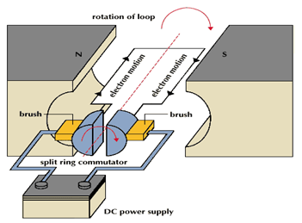
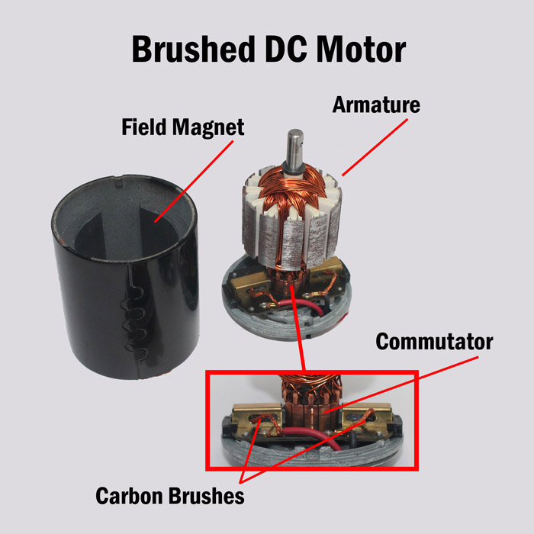
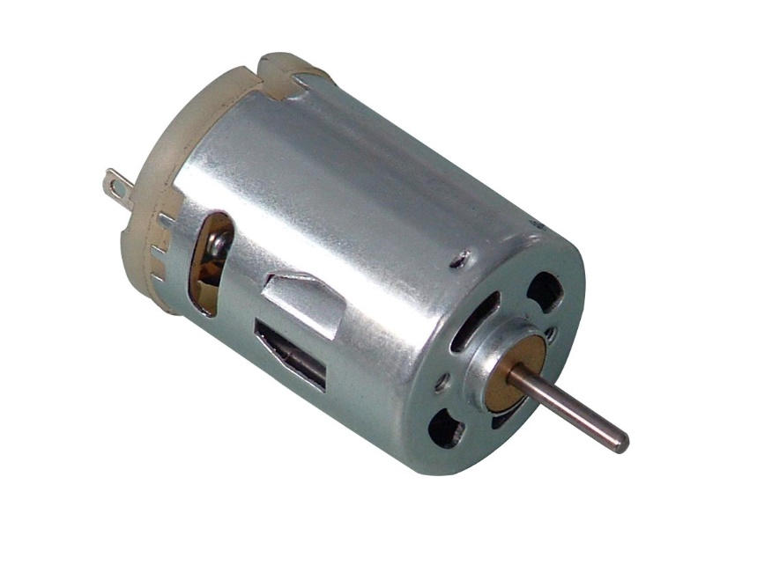
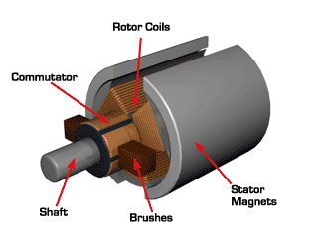

Slide 8
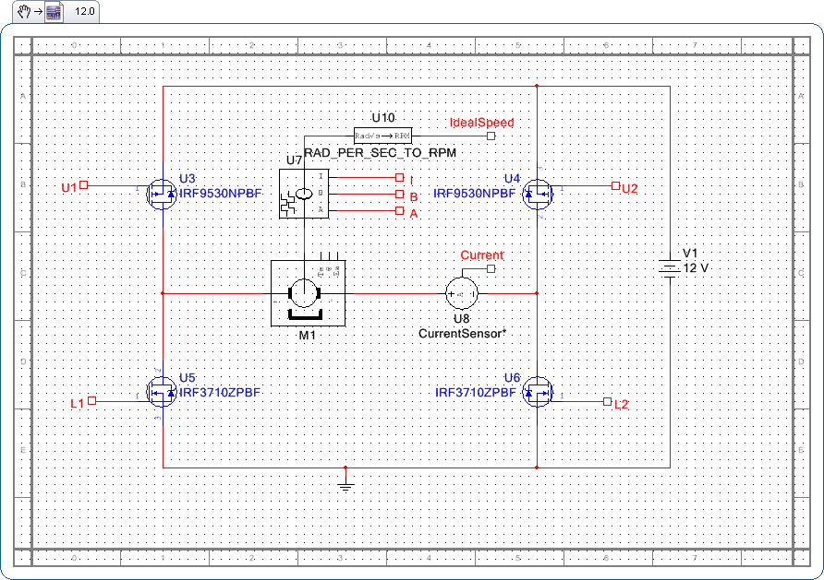
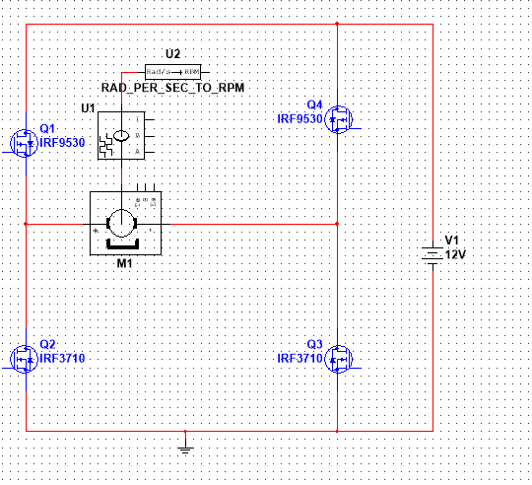
Multisim
Internet found version
My version

Slide 9
Work Cited
www.swigercoil.com/armature-winding-repair.asp
https://community.nxp.com/docs/DOC-1067
Electrical Transformers and Rotating Machines; 4th edition.

Slide 10
Dc Generator Lab
Rotating the wheel counter clockwise does nothing. The LED will not turn on.
Rotating the wheel clockwise lights up the LED.
By flipping the magnet, the blue is matched with red and vise versa, rotating the wheel counter clockwise results in the LED being powered.

Slide 11
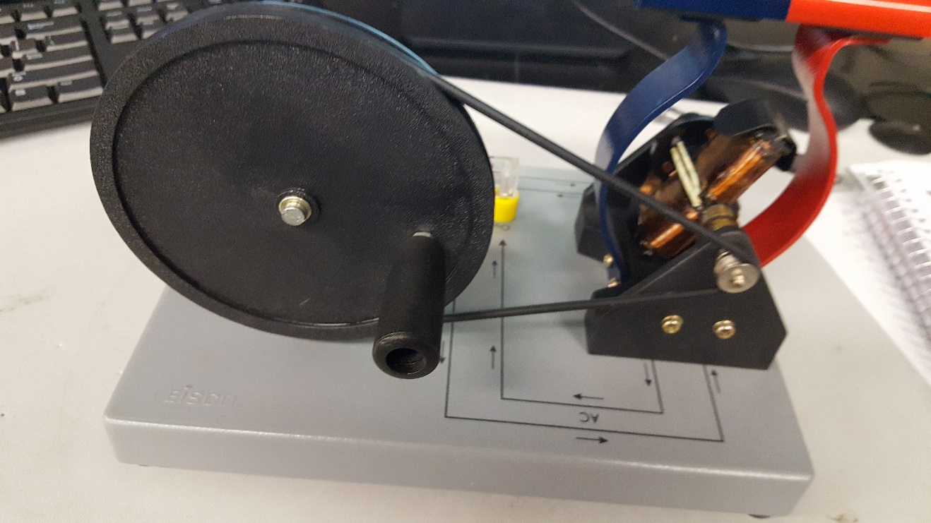
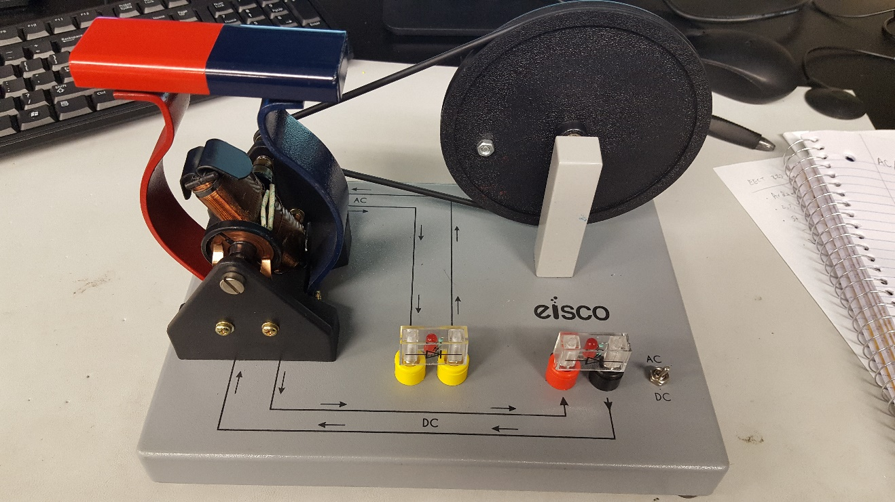
Dc Generator Lab

Slide 12
Ac Generator Lab
Rotating the wheel either direction will power the LED
By flipping the magnet the AC LED has no effect. It’s powered regardless of rotation direction.

Slide 13

Ac Generator Lab
Same generator, simply flip the switch

Slide 14
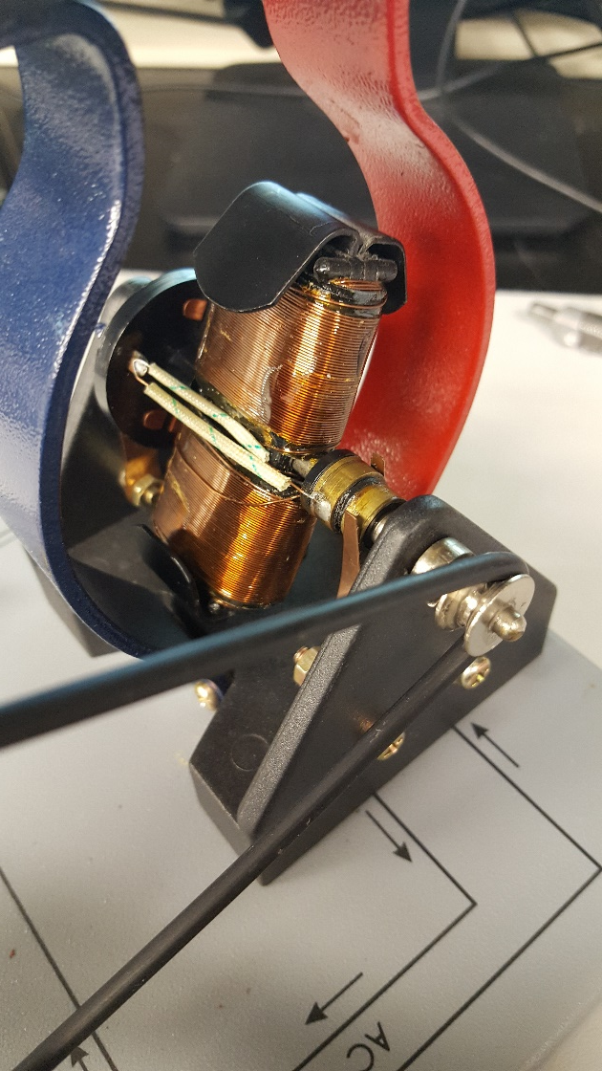
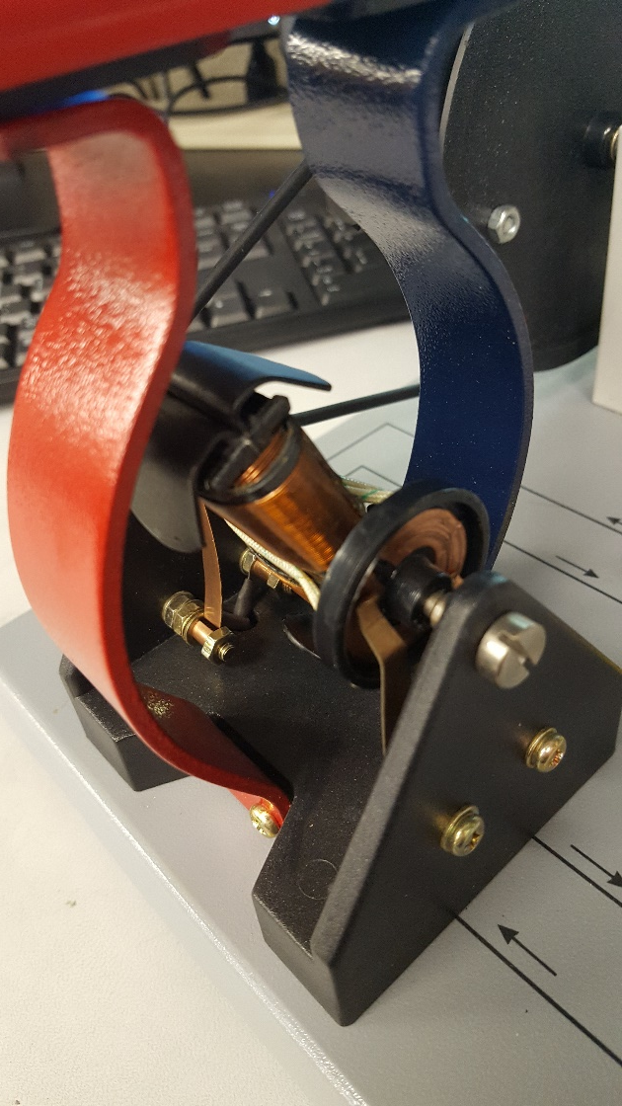
Ac/dc Generator Lab

Slide 15
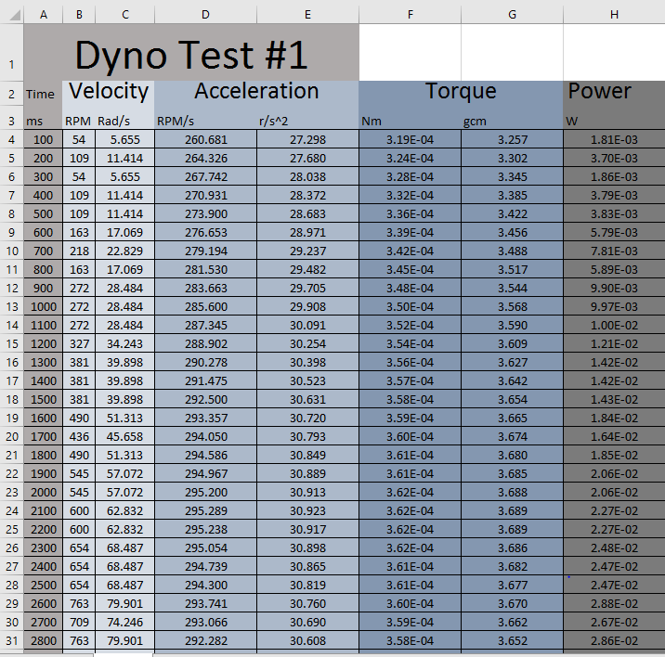
Arduino Based Dyno Lab

Slide 16

Arduino Based Dyno Lab

Slide 17

Arduino Based Dyno Lab

Slide 18
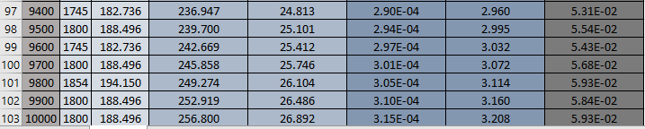
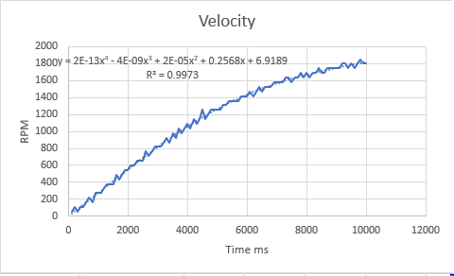
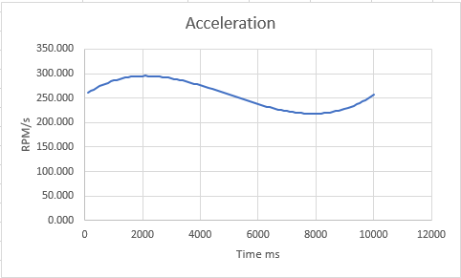
Arduino Based Dyno Lab

Slide 19
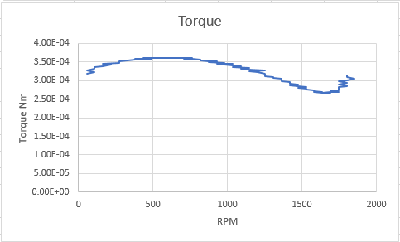
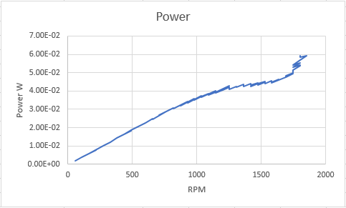
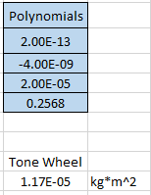
Arduino Based Dyno Lab

Slide 20
Arduino Based Dyno Lab
lastButtonState = buttonState;
curtime = time-prevtime;
if (curtime >= 100){
if (CalibrationMode == 0){
long rpm = (buttonPushCounter*60L/1.1L);
Serial.print(time);
Serial.print(",");
Serial.println(rpm);
prevtime = time;
buttonPushCounter = 0;
}
else{
long rpm = (buttonState);
Serial.print(time);
Serial.print(",");
Serial.println(rpm);
prevtime = time;
buttonPushCounter = 0;
}
}
time = millis();
}
digitalWrite(5, LOW);
//Serial.print("Revolutions = ");
//Serial.println(buttonPushCounter);
//long rpm = (buttonPushCounter*600L);
//Serial.print("RPM = ");
//Serial.println(rpm);
}
void loop() {
}
void setup() {
Serial.begin(115200);
pinMode(5, OUTPUT);
pinMode(A0, INPUT);
int buttonPushCounter = 0;
int buttonState = 0;
int lastButtonState = 0;
int swcount = 0;
int pulsewidth = 0;
//Run Parameters
int RunTime = 5000; //Time is in milliseconds
int CalibrationMode = 0; //0 outputs rpm vs time, 1 outputs raw sensor data
int SensorCutoff = 130; //Sensor value between high and low state
int MotorSpeed = 100; //Expressed as a percentage from 100% to 0%
analogReference(EXTERNAL);
unsigned long time;
unsigned long prevtime;
unsigned long curtime;
time = millis();
prevtime = 0;
curtime = time-prevtime;
pulsewidth = (MotorSpeed/100)*255;
while ((time) <RunTime){
buttonState = analogRead(A0);
digitalWrite(5, pulsewidth);
if (buttonState > SensorCutoff){
if (lastButtonState <= SensorCutoff){
buttonPushCounter++;
lastButtonState = buttonState;
}
}
//if (buttonState == 0){
//lastButtonState = 0;
//}

Slide 21
Arduino Based Dyno Lab
http://www.instructables.com/id/RC-Motor-Dynamometer-V10/

Slide 22
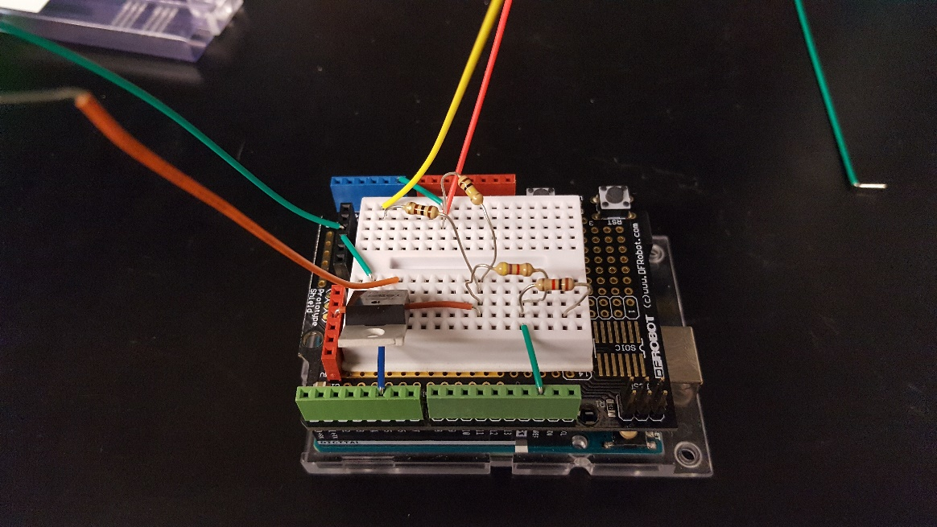
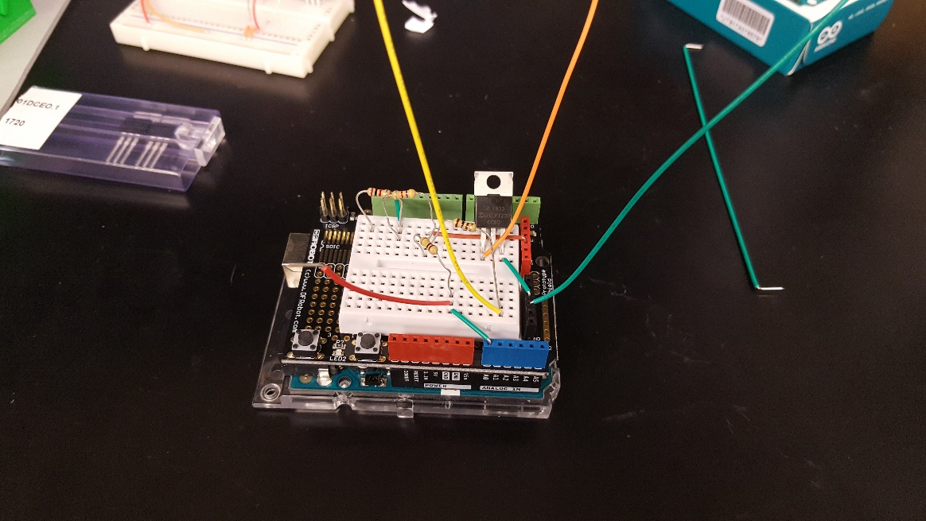
Arduino Based Dyno Lab

Slide 23
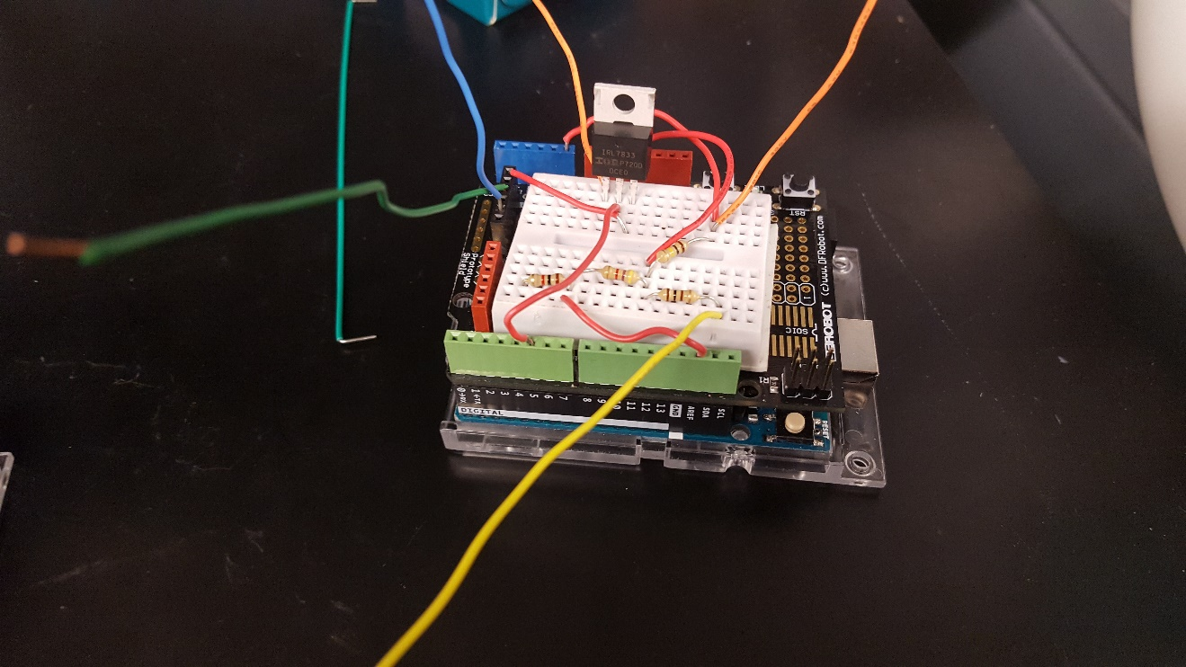
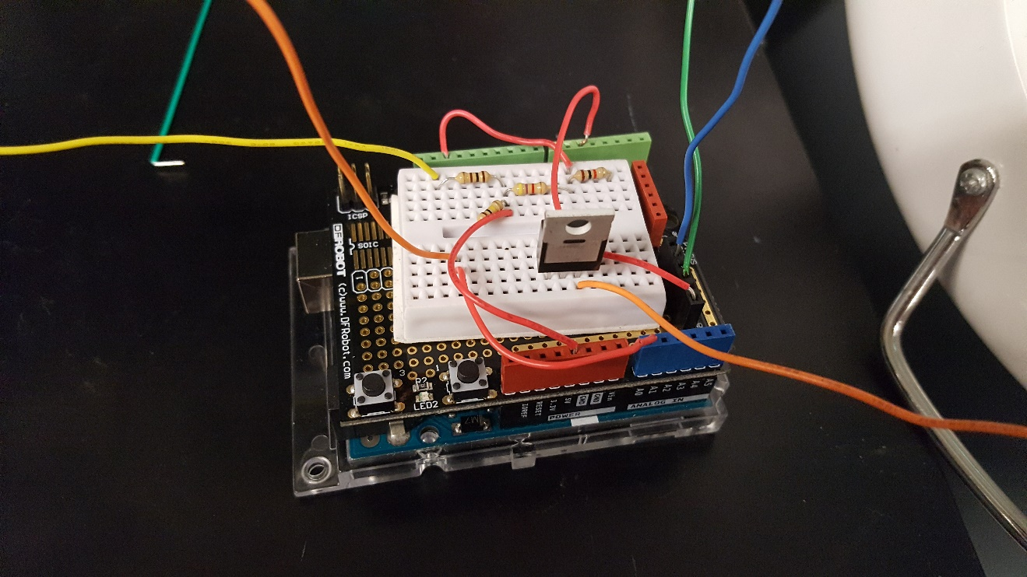
Arduino Based Dyno Lab

Slide 24
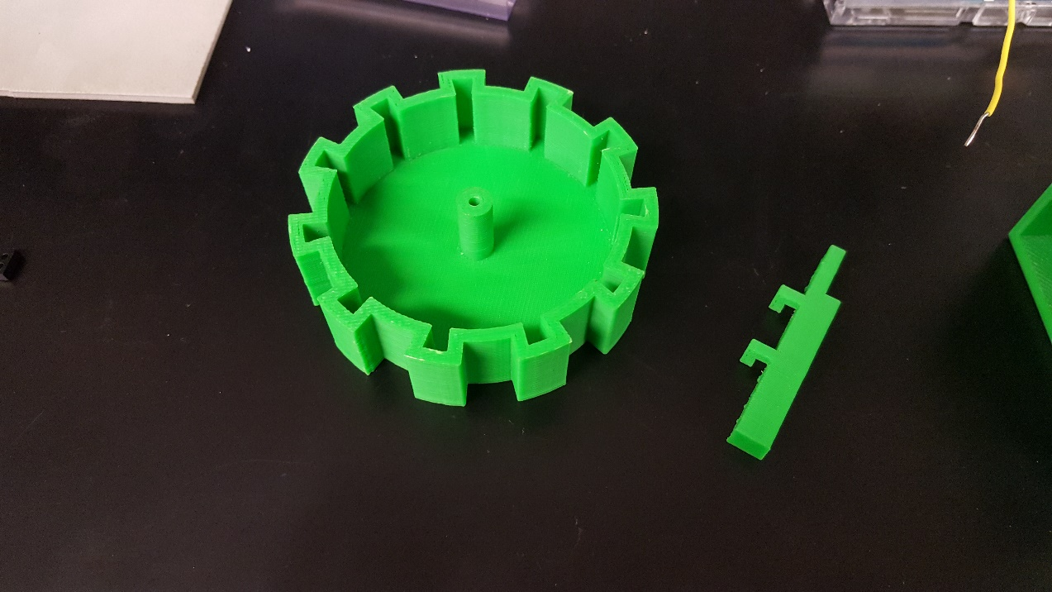
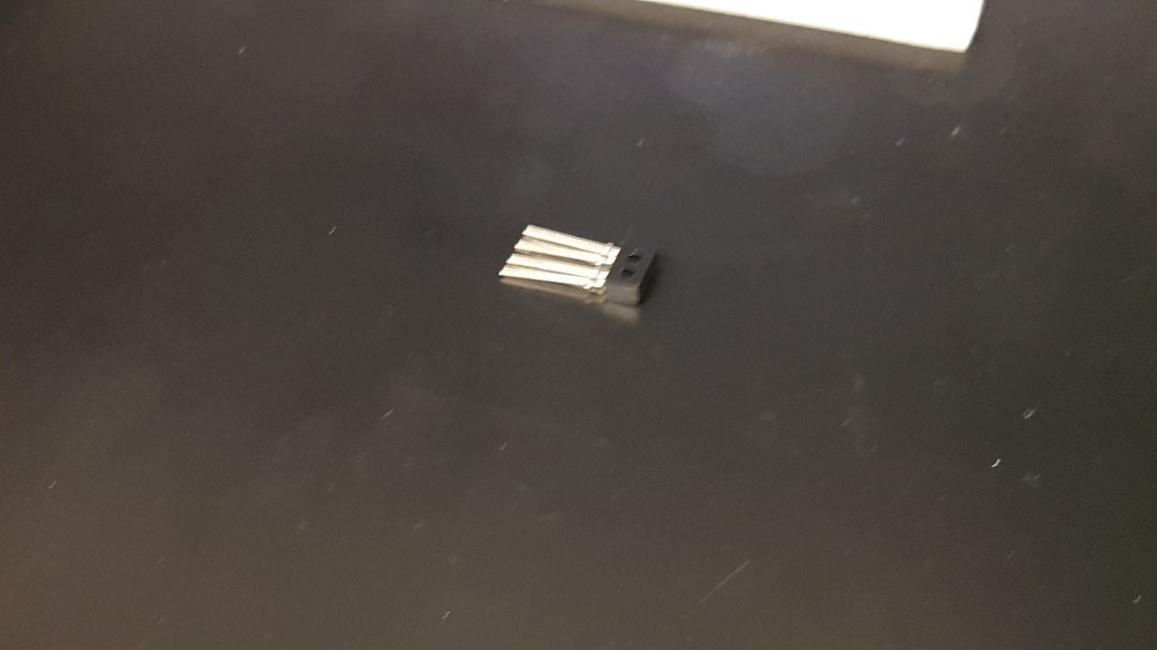
Arduino Based Dyno Lab

Slide 25
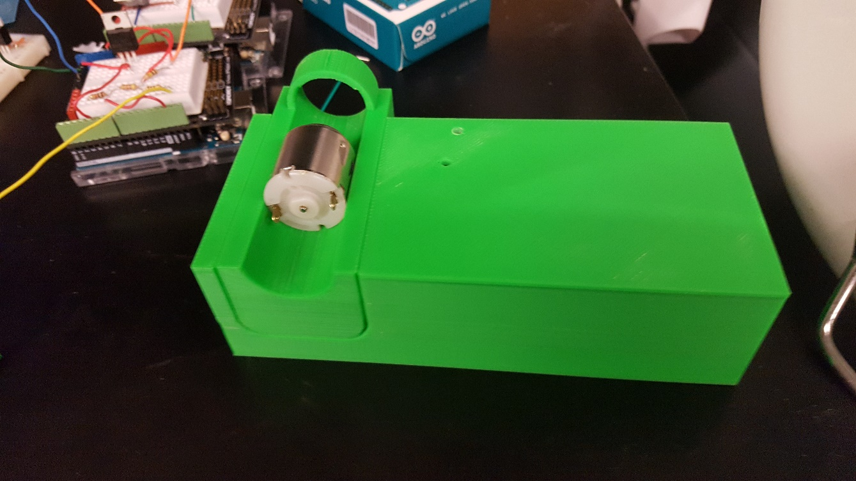
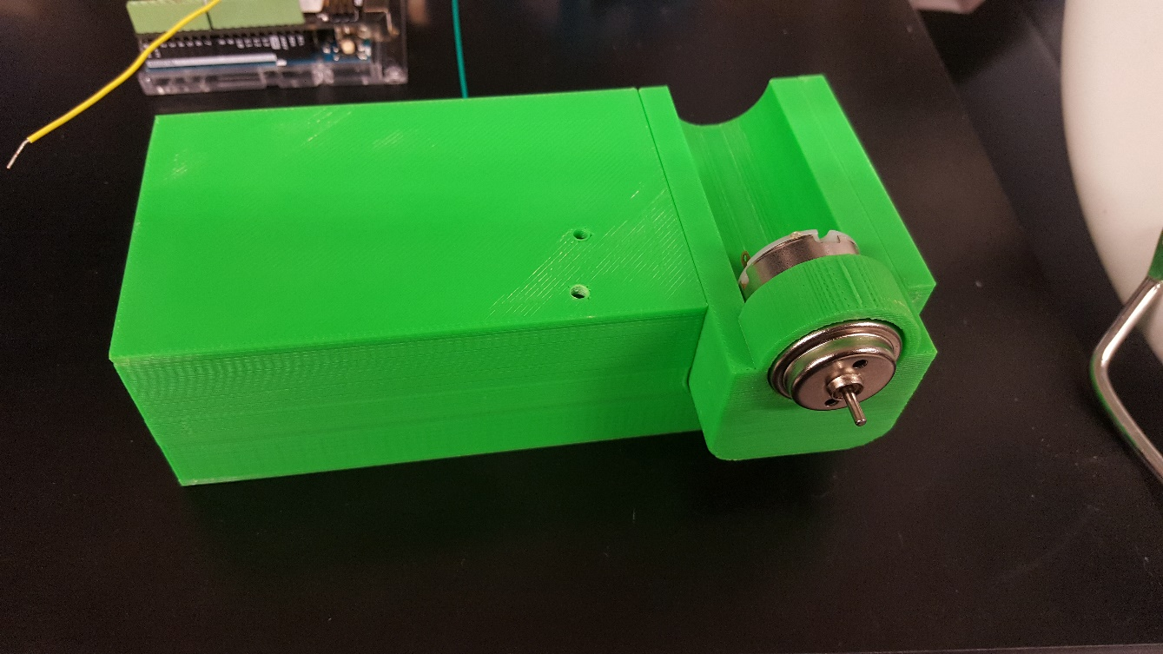
Arduino Based Dyno Lab

Slide 26
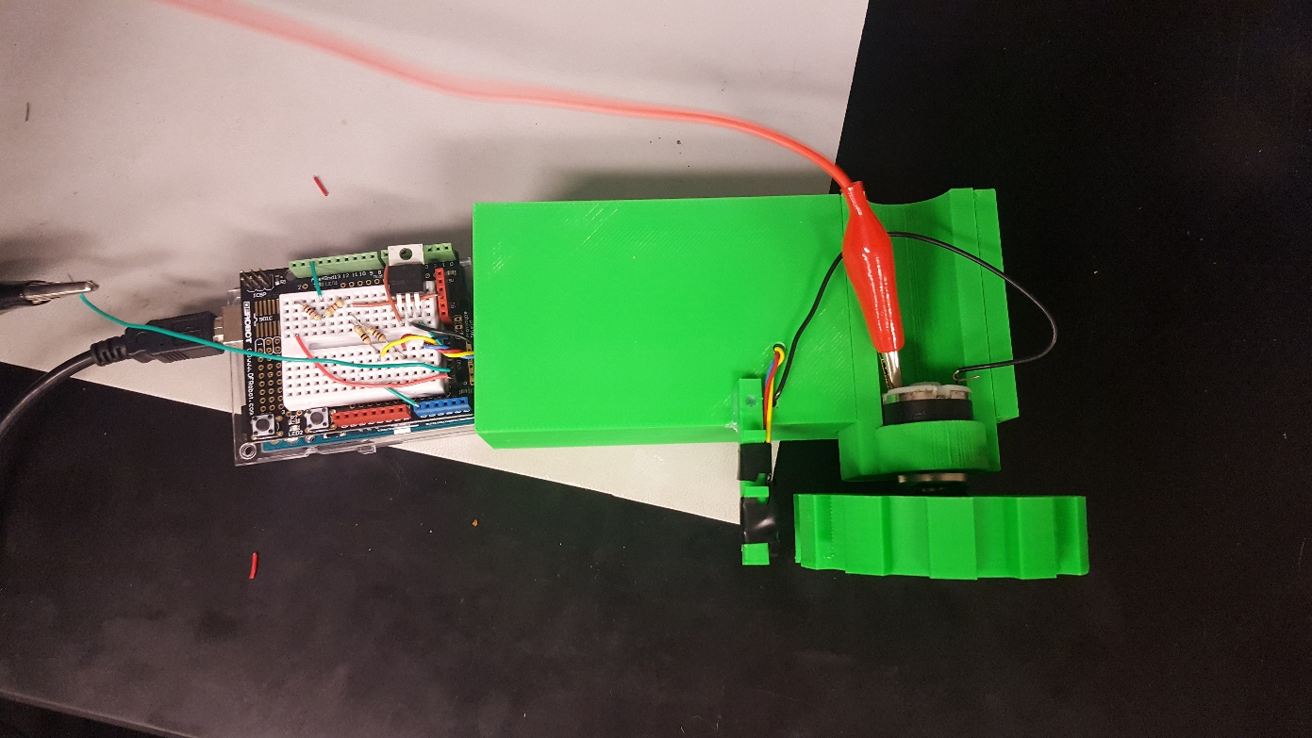
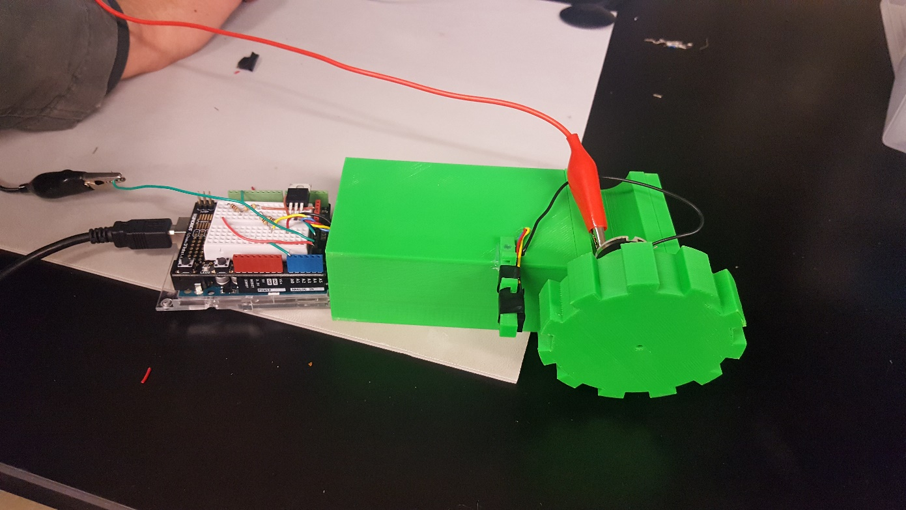
Arduino Based Dyno Lab

Slide 27
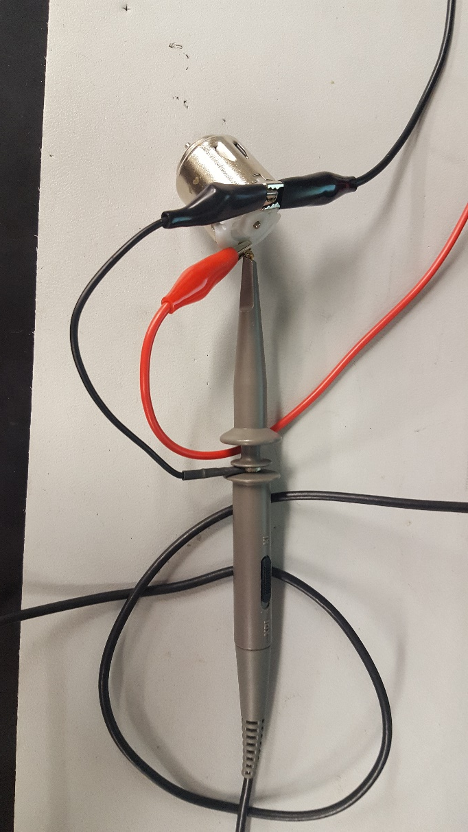
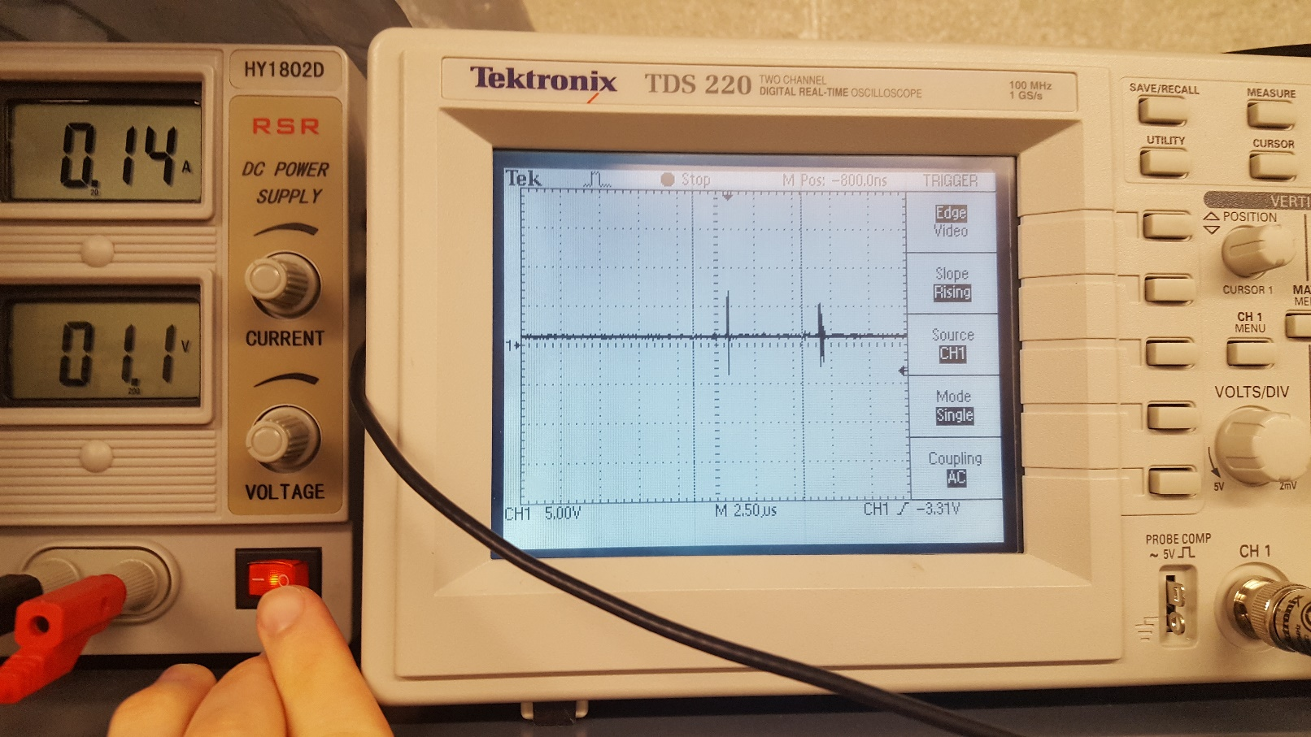
small basic motor test
3v DC motor

Slide 28
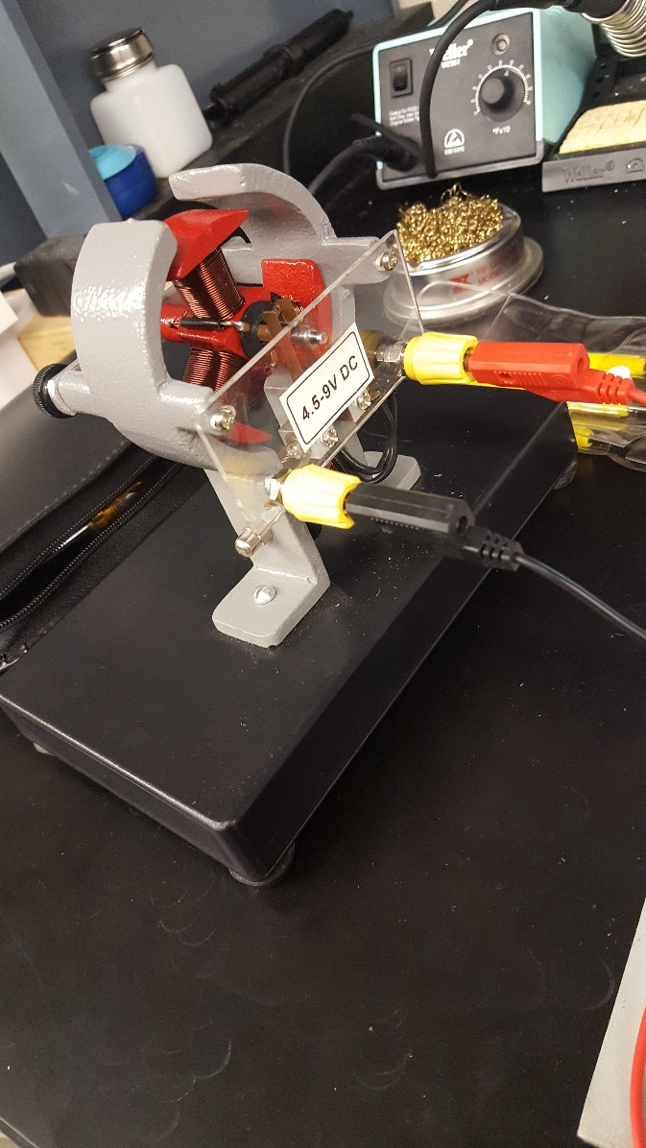
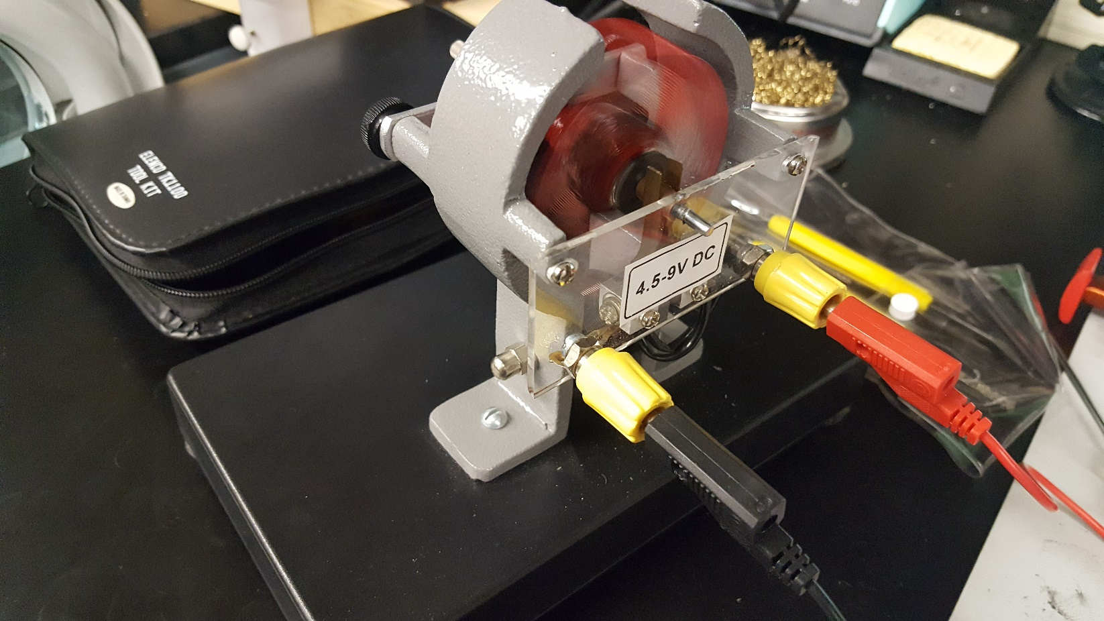
multiple pole dc motor test

Slide 29
multiple pole dc motor test
2 pole armature:
1.70A
2.3v
Electro magnetized
Needs a push or applied torque to start running

Slide 30
multiple pole dc motor test
3 pole armature:
1.10A
1.6v
Electro magnetized
Needs a push or applied torque to start running
Using the same current and voltage as the 2 pole armature test, the 3 pole runs faster

Slide 31
multiple pole dc motor test
4 pole armature:
2.20A
3v
Electro magnetized
Needs a push or applied torque to start running
Using the same current and voltage as the 3 pole armature test, the 4 pole runs faster

Slide 32
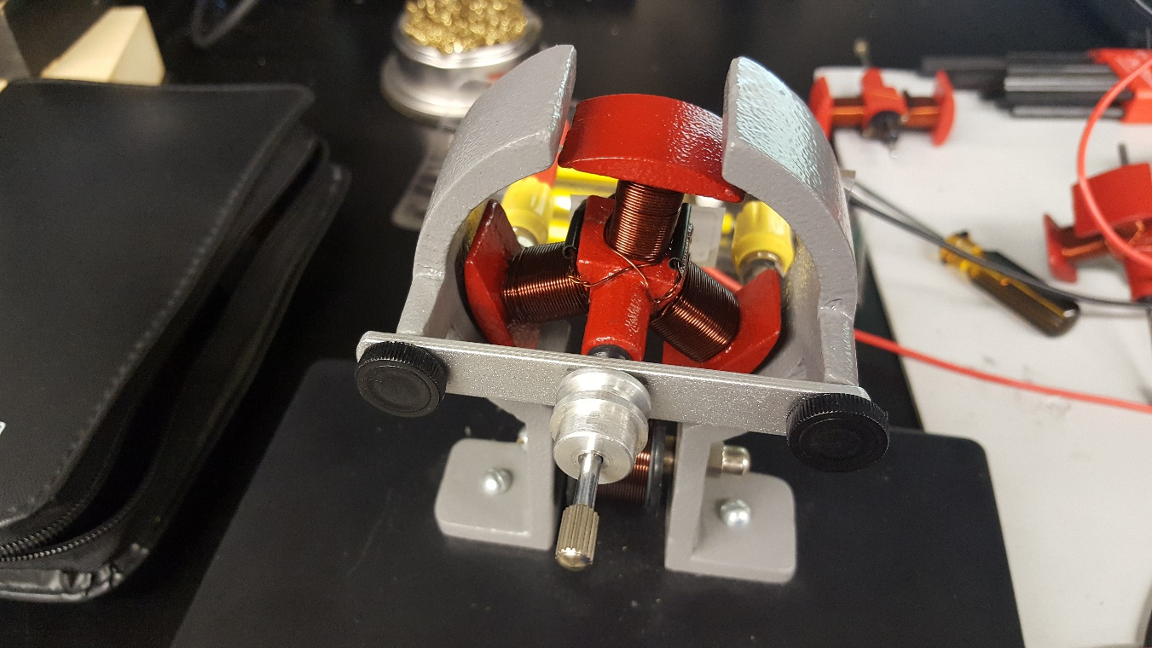
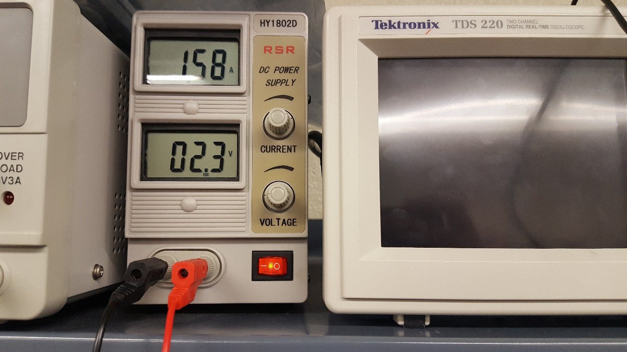
multiple pole dc motor test

Slide 33
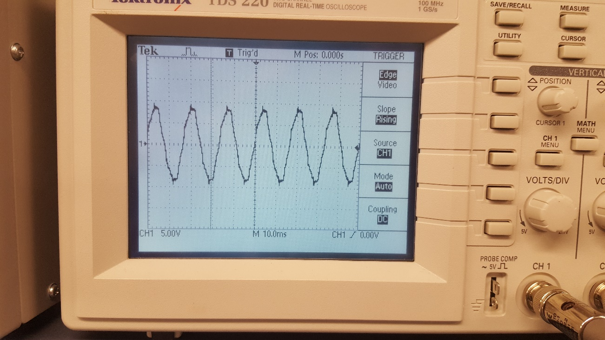
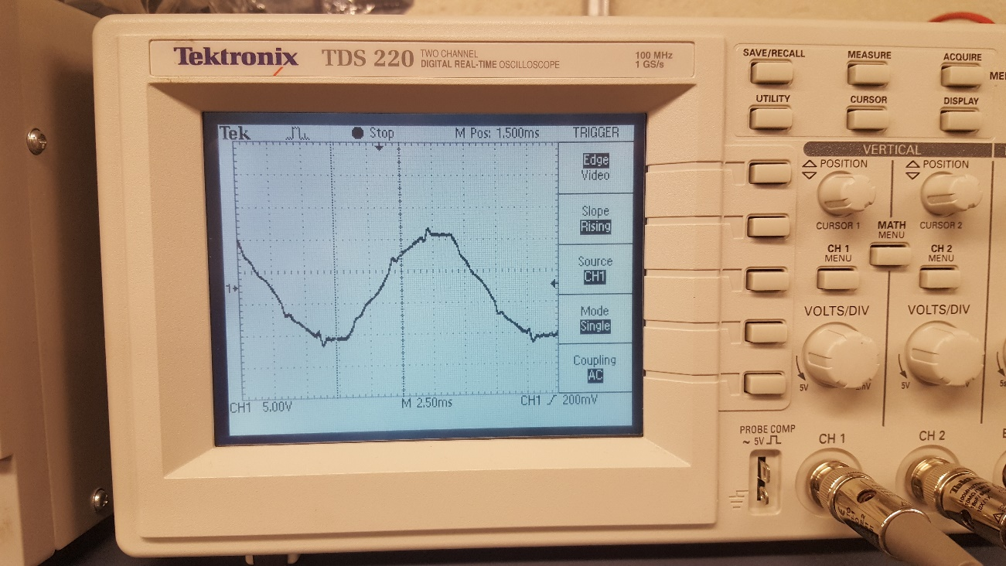
multiple pole dc motor test

Slide 34
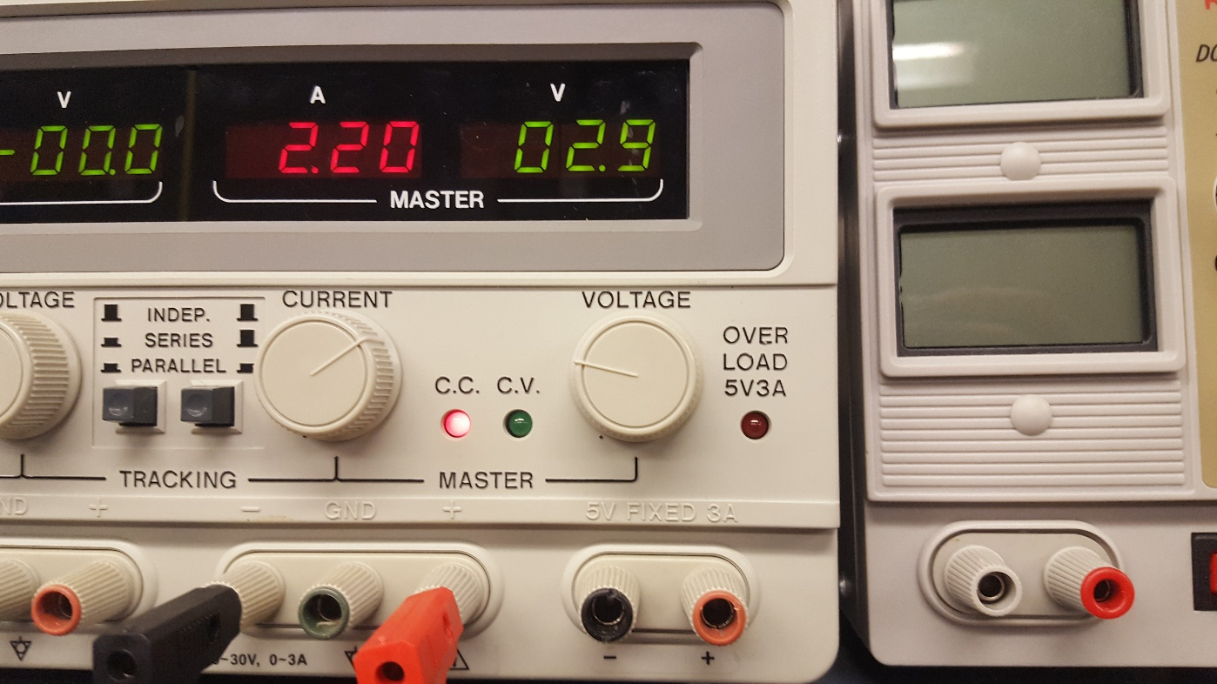
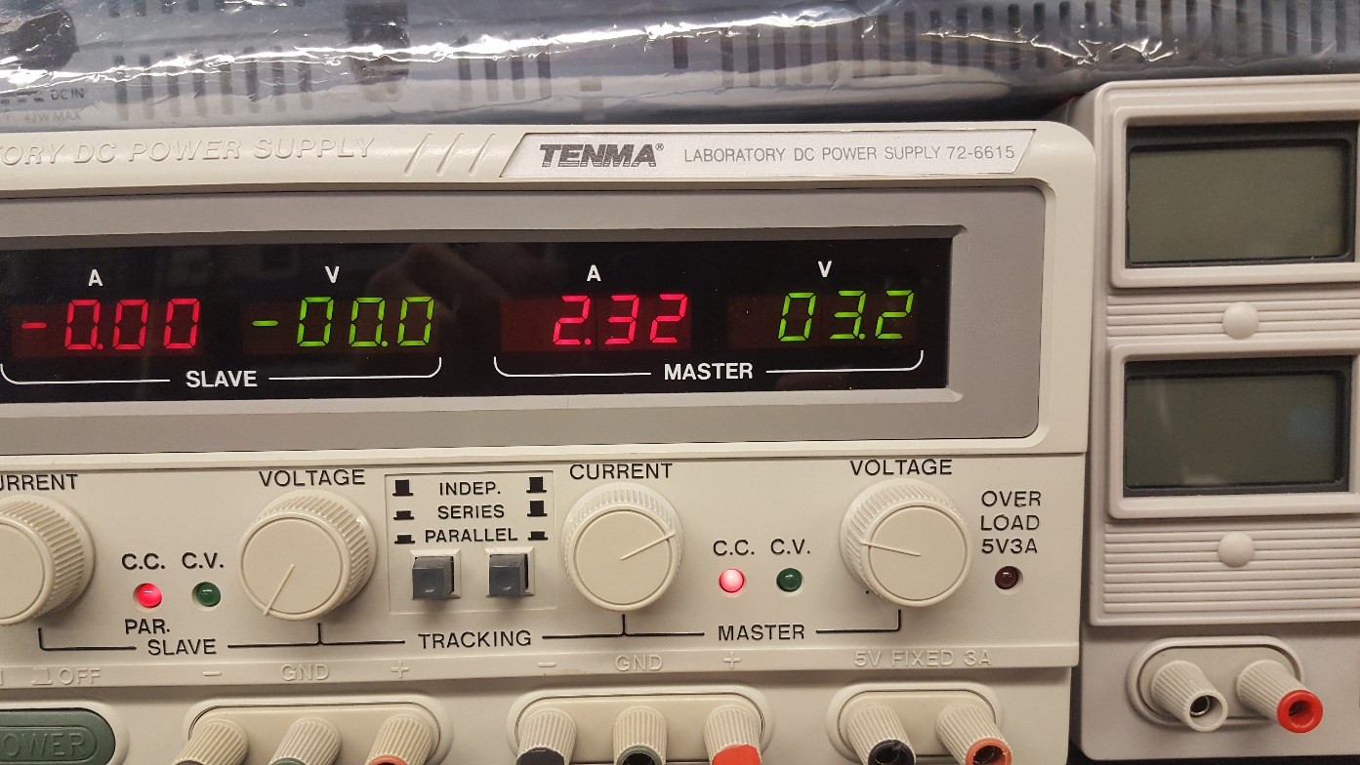
multiple pole dc motor test

Slide 35
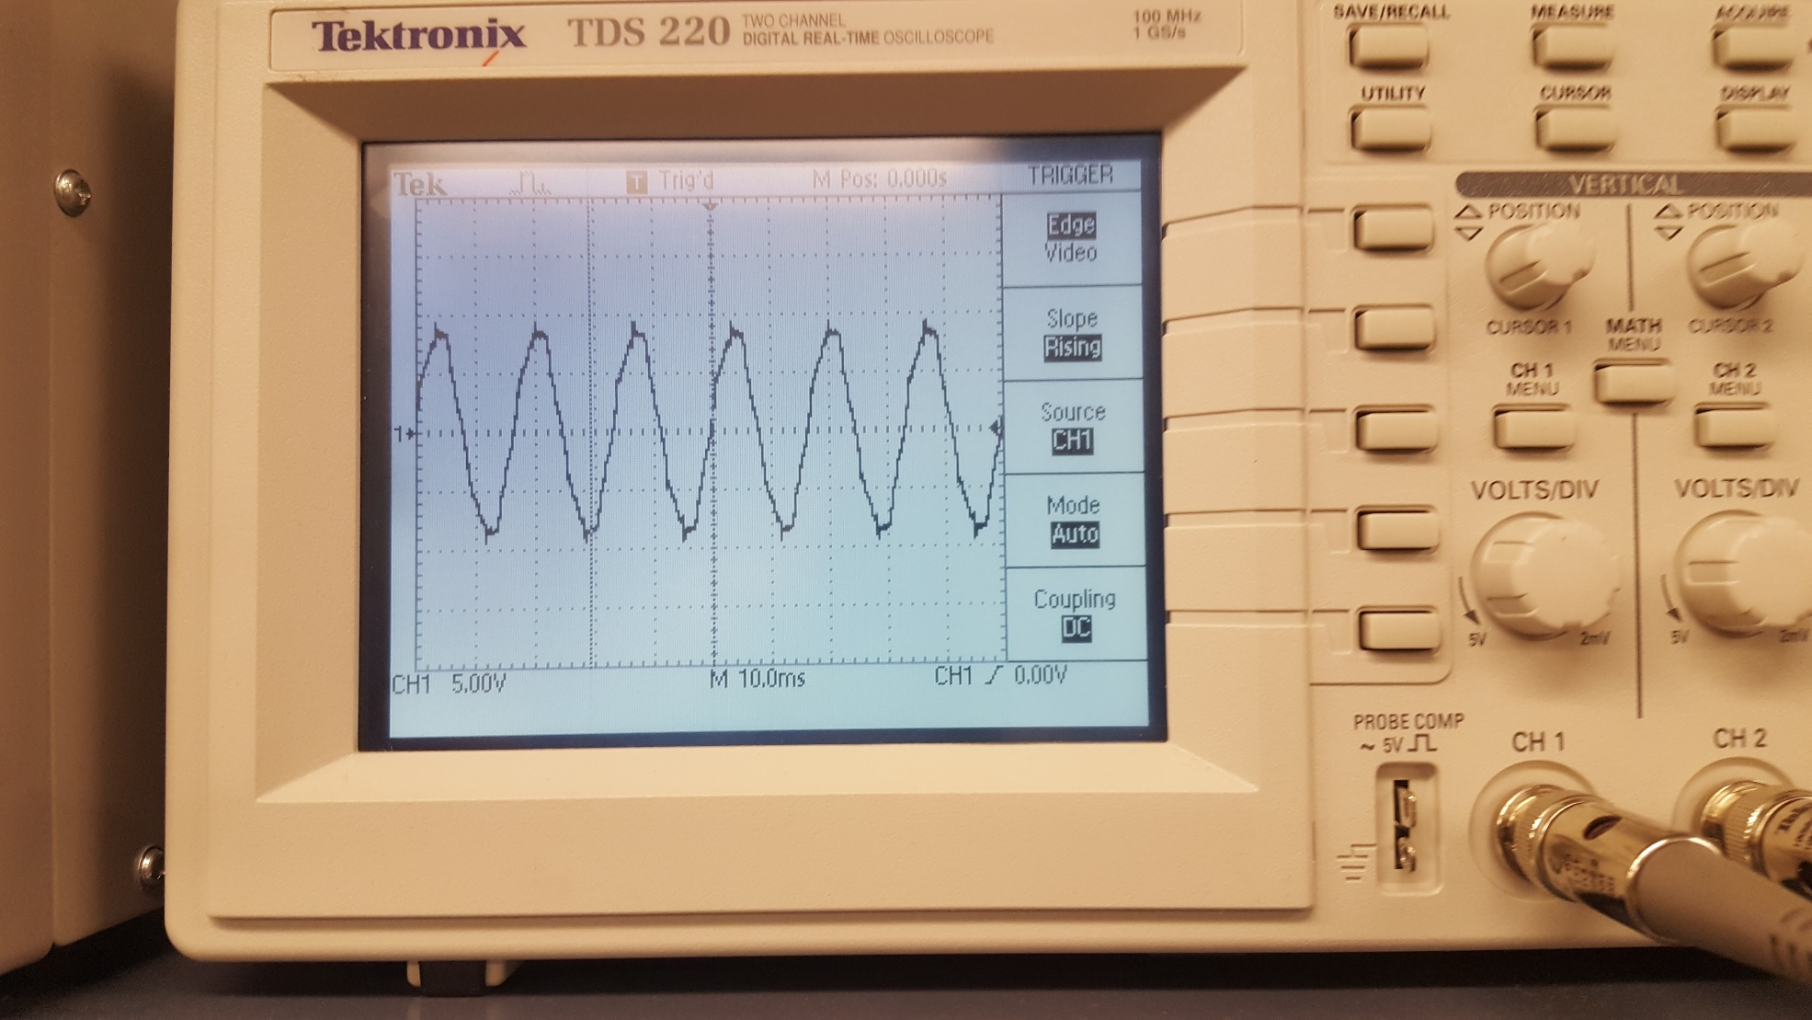
multiple pole dc motor test

Slide 36
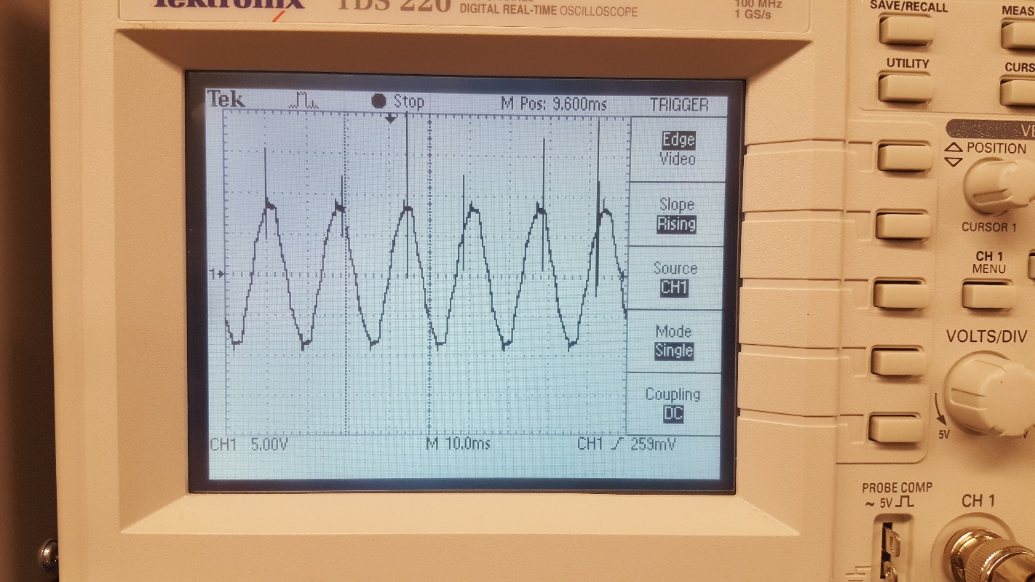
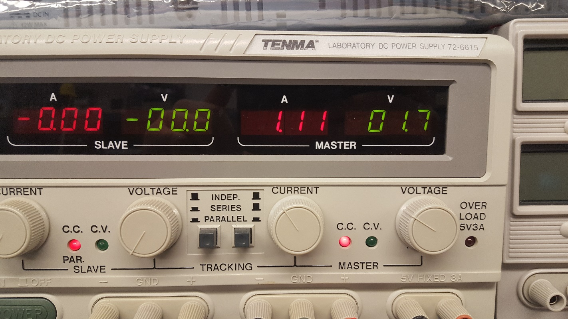
multiple pole dc motor test

Slide 37
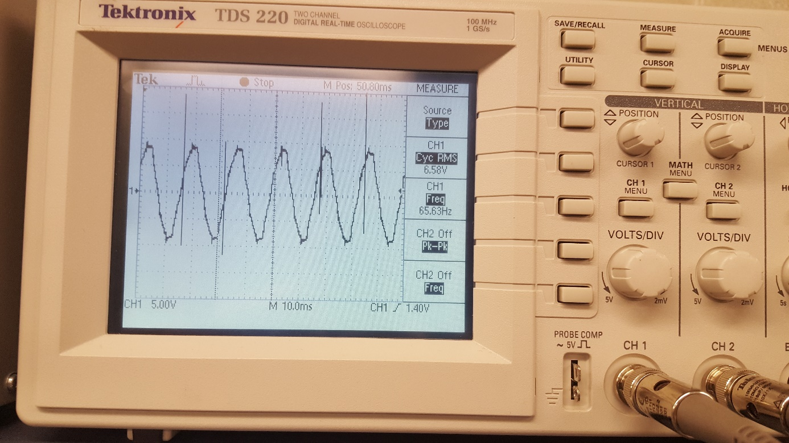
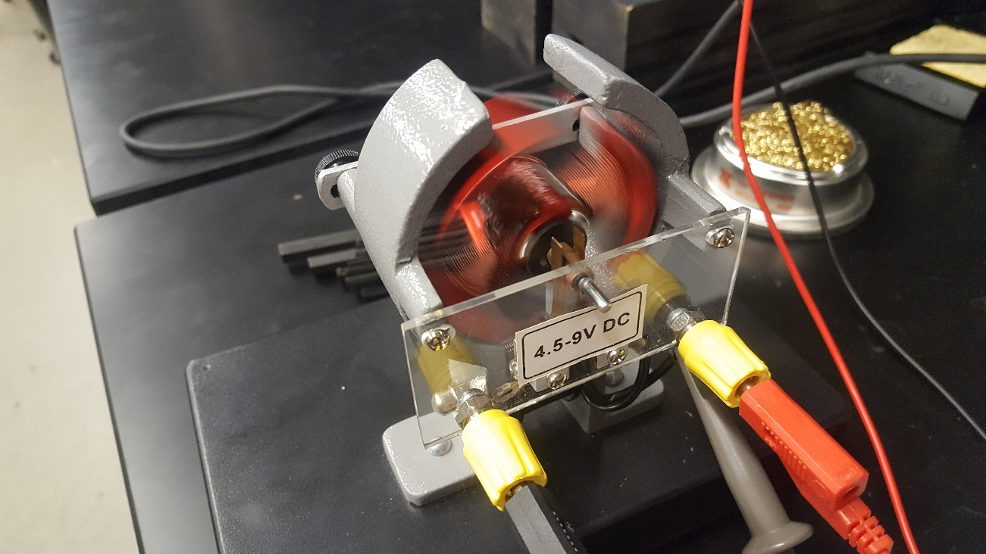
multiple pole dc motor test

Slide 38
Difference between shunt and series
A shunt motor has the field windings connected in parallel with the armature and a series motor has the field windings connected in series with the armature. Shunt windings are parallel and hence have low current and Series motors have series windings, thus having a high armature current which is the same as field current.
https://www.quora.com/What-is-the-difference-between-a-DC-shunt-and-a-series-motor

Slide 39
Difference between shunt and series
Shunt Motor Characteristics
The different characteristics have been discussed in Art.
It is clear that
(a) speed of a shunt motor is sufficiently constant.
(b) for the same current input, its starting torque is not a high as that of series motor.

Slide 40
Difference between shunt and series
Series Motor Characteristics
A relatively huge starting torques.
Have good accelerating torques.
Have low speed at high loads and dangerously high speed at low loads.
When a large starting torque is required i.e. for driving hoists, cranes, trams etc.
When the motor can be directly coupled to a load such as a fan whose torque increases with speed.
If constancy of speed is not essential, then, in fact, the decrease of speed with increase of load has the advantage that the power absorbed by the motor does not increase as rapidly as the torque. For instance, when torque is doubled, the power approximately increases by about 50 to 60% only.
A series motor should not be used where there is a possibility of the load decreasing to a very small value. Thus, it should not be used for driving centrifugal pumps or for a belt-drive of any kind.
http://machineryequipmentonline.com/electric-equipment/d-c-motorcomparison-of-shunt-and-series-motors/

